Slide 1
Scrum Masters Inc.
Software Architecture Document and Prototype

Slide 2
Software Architecture Document

Slide 3
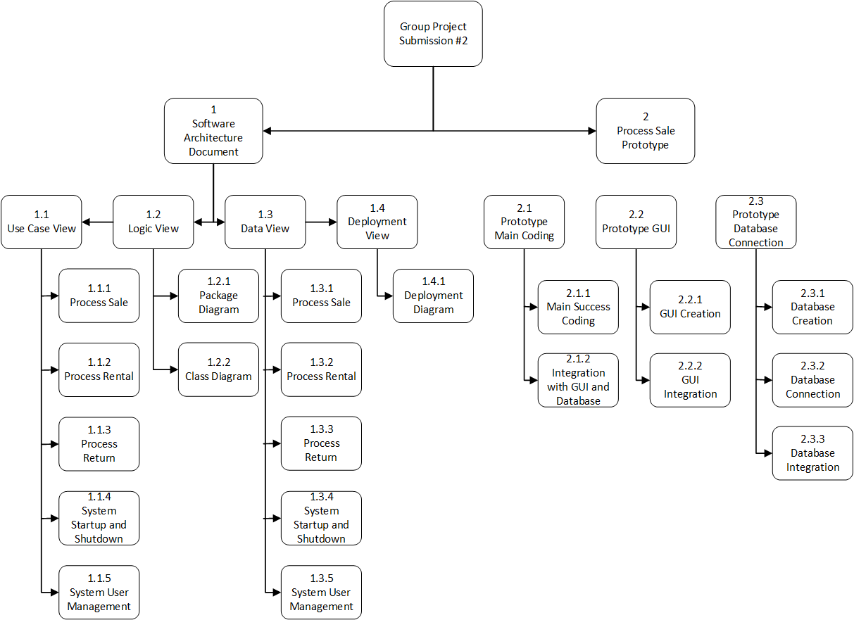
Work Breakdown Structure (WBS)

Slide 4
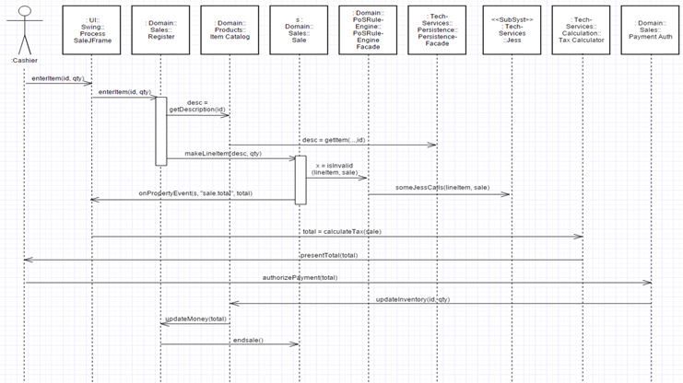
Use Case View: Process Sale

Slide 5
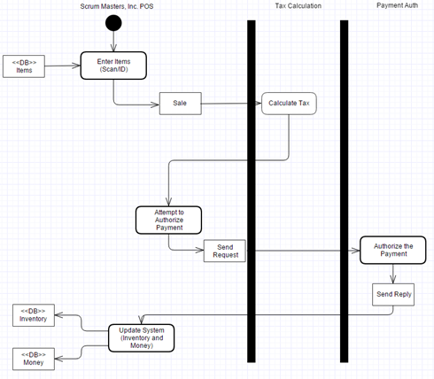
Data View: Process Sale

Slide 6
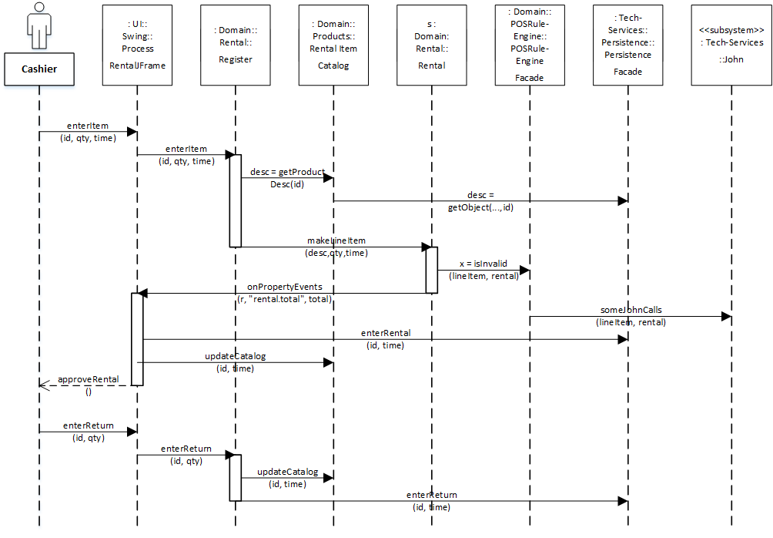
Use Case View: Process Rental

Slide 7
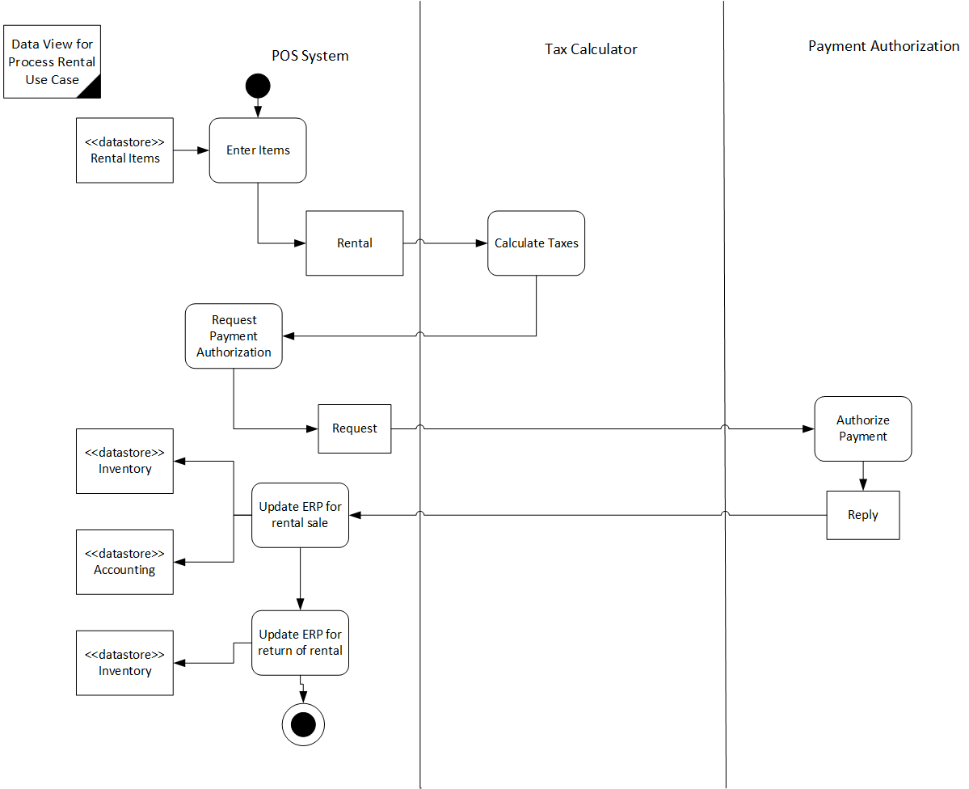
Data View: Process Rental

Slide 8
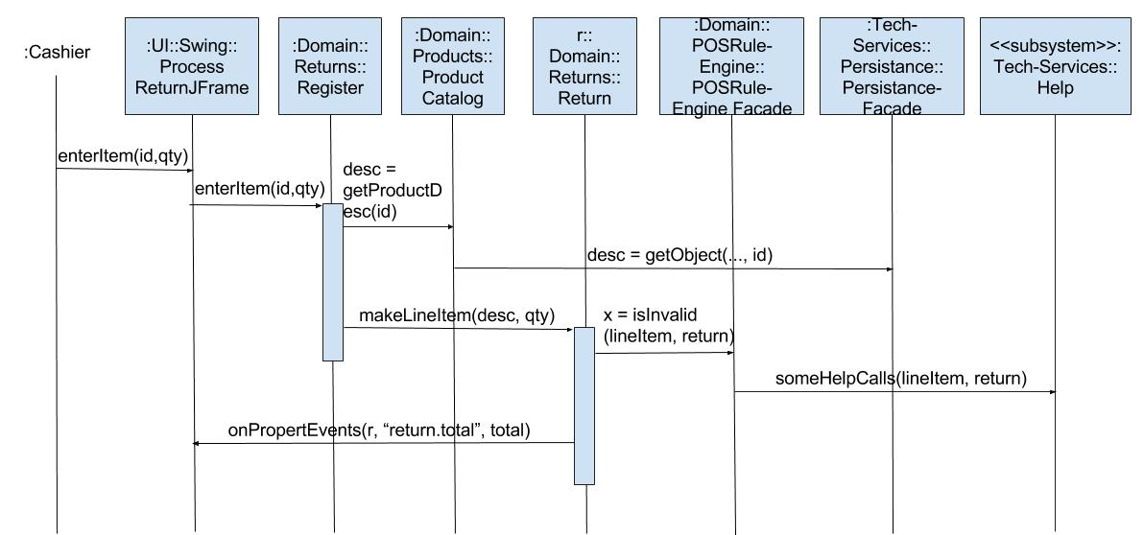
Use Case View: Process Return

Slide 9
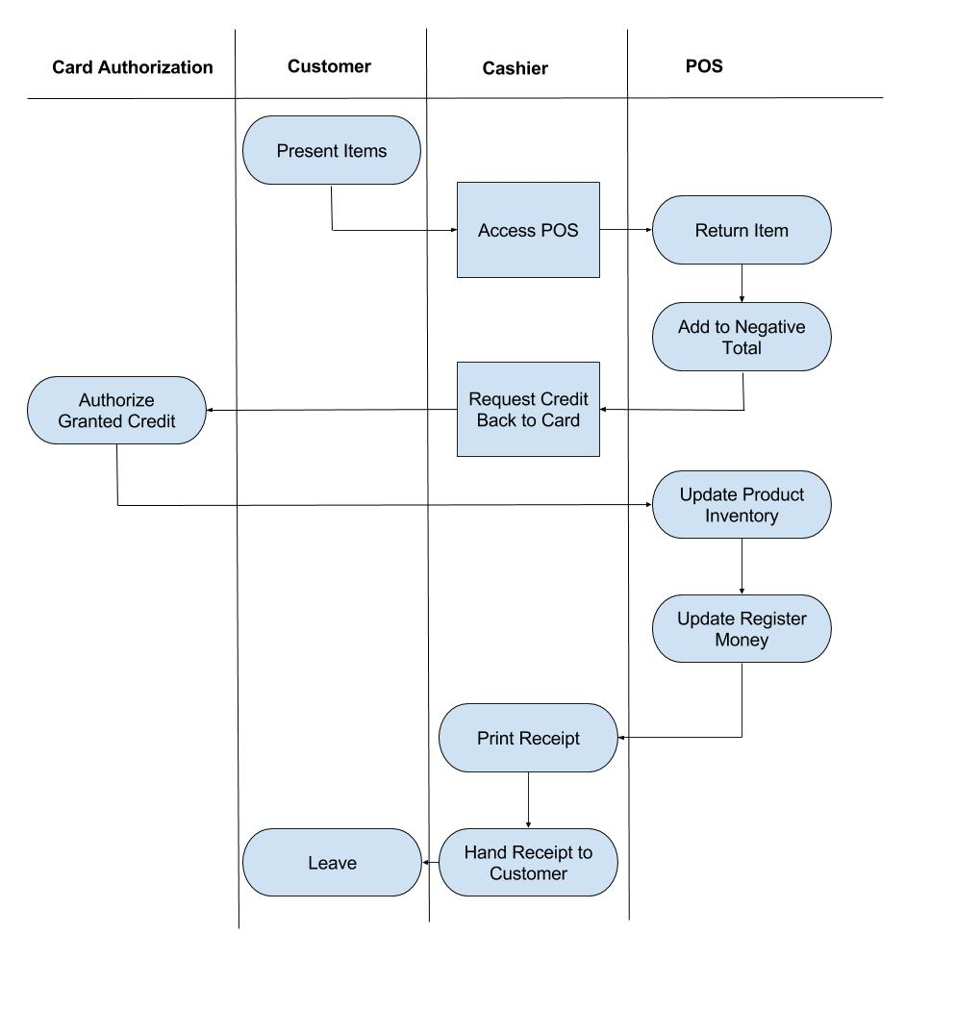
Data View: Process Return

Slide 10
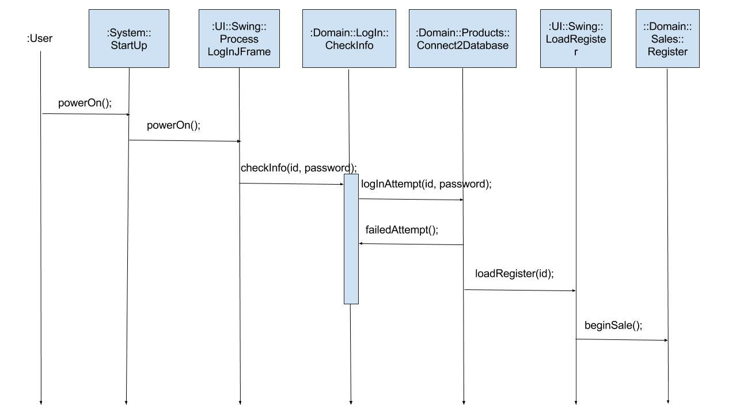
Use Case View: System Startup and Shutdown

Slide 11
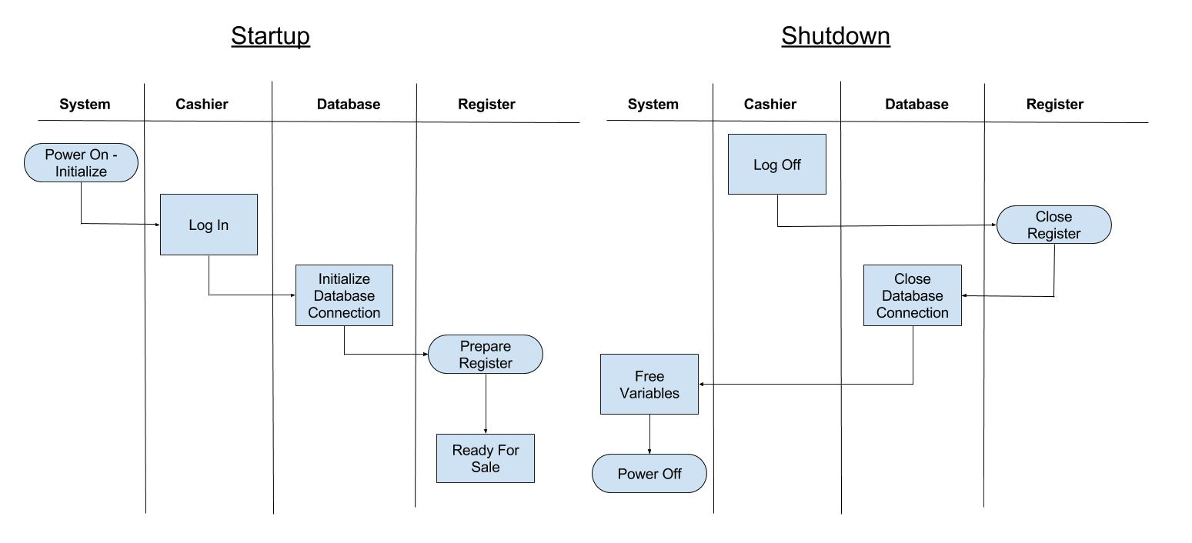
Data View: System Startup and Shutdown

Slide 12
Use Case View: System User Management

Slide 13
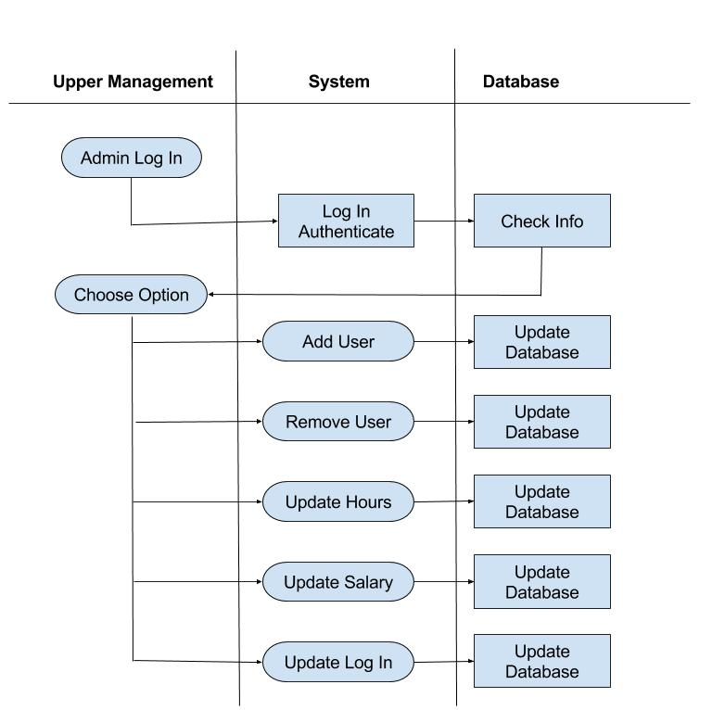
Data View: System User Management

Slide 14
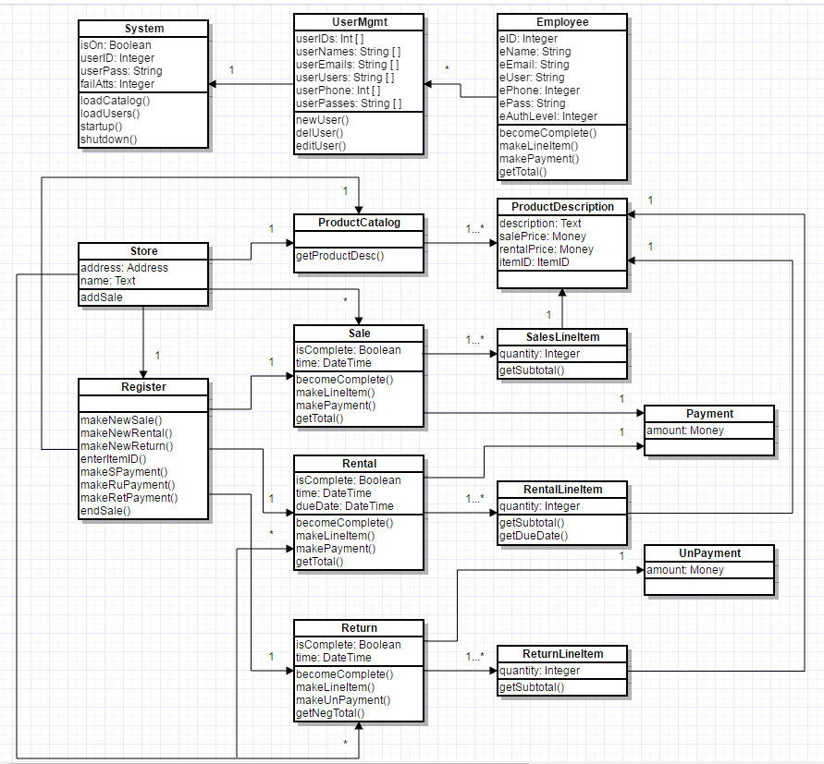
Class Diagram of Use Cases

Slide 15
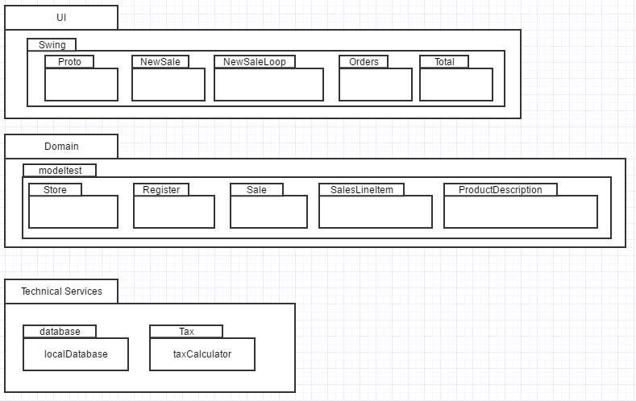
Package Diagram

Slide 16
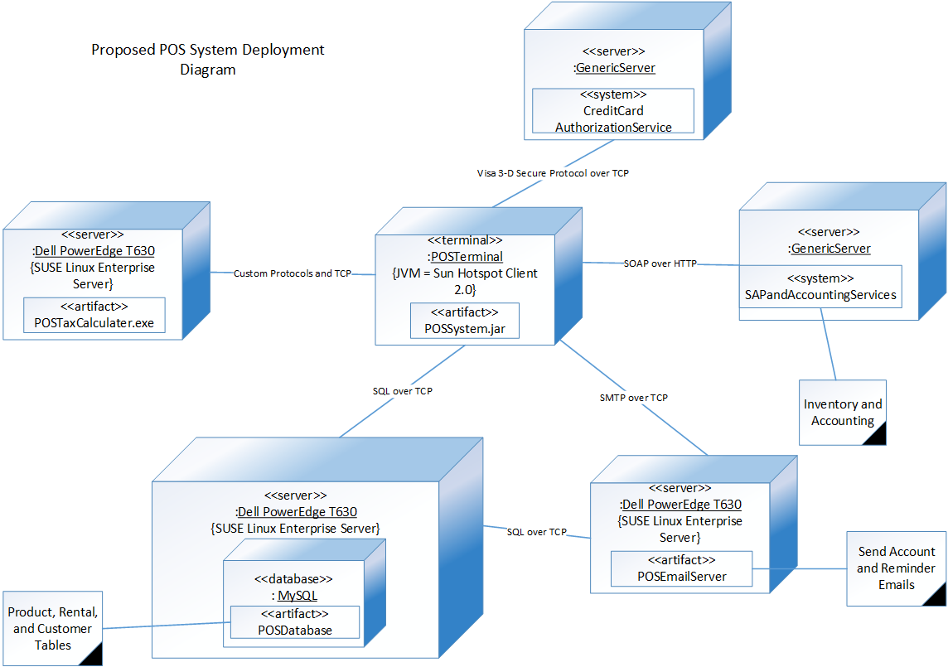
Deployment Diagram

Slide 17
Prototype Demo

